Slide 1
Leased vs. Owned
Product Comparison
Data Analysis Collaborated by:
Nick Sain
Joshua Cohen
Anita Prevatte
Cara Roberts
*All raw data was compiled from customer product and maintenance costs csv from 2015 to present.

Slide 2
Is it more effective to own or lease your powered equipment? Cost per Hour is a key metric used to measure the cost of individual or groups of equipment, employees, & facilities.

Slide 3
Executive Summary
Analysis was performed based on company data provided by the finance department. We scrubbed data dated back to 2015 until present, to compare the cost efficiency of leased vs. owned equipment.

Slide 4
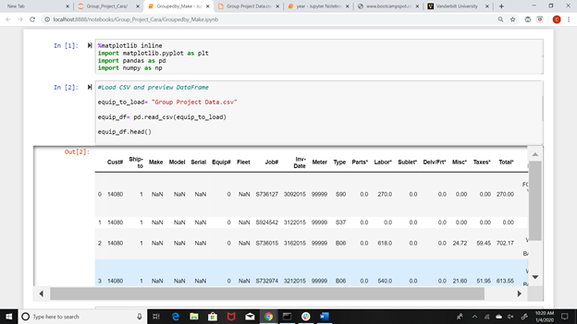
Data Sourcing

Slide 5
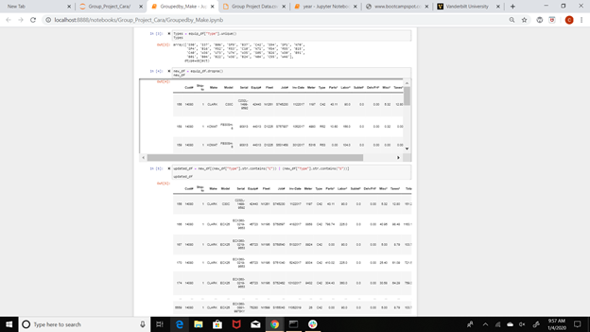
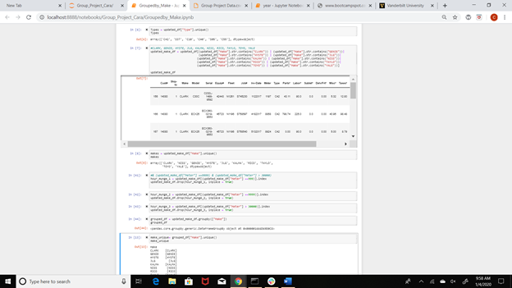
Data Munging

Slide 6
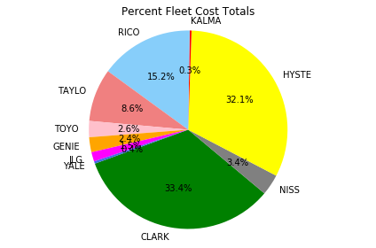
Make Percentages of Total Cost
Percentages Pie Chart gives a better perspective CLARK and HYSTE surpass other Fleets in total cost.
RICO and TAYLO are a distant third and forth cost total in overall comparison.

Slide 7
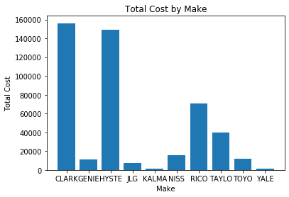
Analysing Data by Make and Their Total Cost
CLARK and HYSTE had the total cost amongst fleets/makes.
However, further depth of calculations was needed to provide the the cost efficiency of each make.

Slide 8
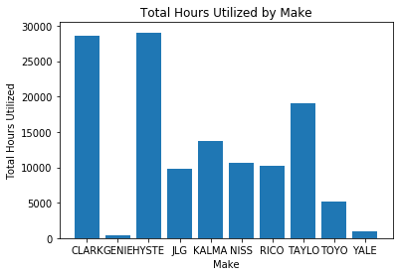
Total Hours Utilized By Make
Hours Utilized are an important variable in Cost Efficiency.
Total hours utilized are a clear representation CLARK and HYSTE were the two most used Makes.
CLARK and HYSTE is trending to be top amongst the Makes.
However, notice the GENIE make has extremely low hours utilized.

Slide 9
CLARK and HYSTE Trend
Side By Side COST and HOURS UTILIZED Comparison

Slide 10
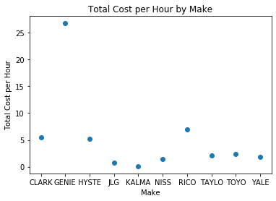
Occasions of OUTLIERS in Data
Given the scatter plot, GENIE surprisingly, although hinted in a previous slide, is the highest Cost per Hour by Make.
Even though GENIE has a low overall Total Cost, GENIE’s extremely low Hours Utilized has skewed its Cost/Hour noticeably higher than other makes.
GENIE was clearly not utilized enough to offset initial costs.
Outliers like this should normally be taken out of a dataset to give a consistent range of mode.

Slide 11
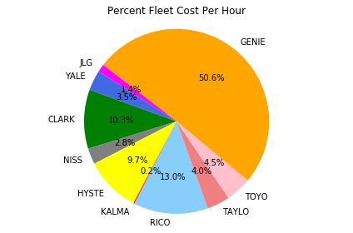
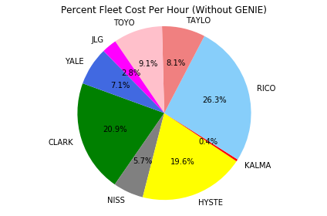
Perspective of Individual
Make Cost Per Hour
Outlier (GENIE) removed only for individual charting to improve visualization.

Slide 12
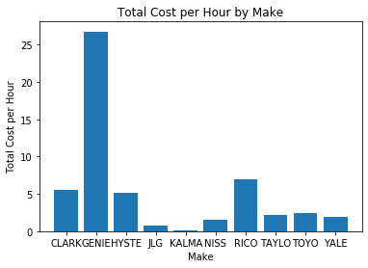
Cost Per Hour Comparison
Make: Cost per Hour
CLARK: 5.471148
GENIE: 26.755201
HYSTE: 5.138567
JLG: 0.725855
KALMA: 0.100409
NISS: 1.484722
RICO: 6.894155
TAYLO: 2.107753
TOYO: 2.393147
YALE: 1.862848
Given the Data Frame and Bar Chart, CLARK and HYSTE are a reliable trend in comparison.
The two highest ranking are surpassed by RICO by a full dollar more per hour.
With the individual Make data, further calculations can be made to give a Cost per Hour Comparison between Leased vs. Owned Makes.

Slide 13
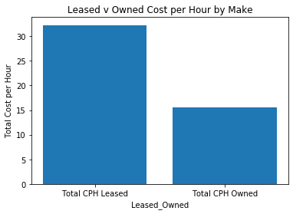

Leased vs. Owned
Make Comparison with Genie (Cost Per Hour)
Total CPH Leased Total CPH Owned
Cost per Hour 32.226349 15.568888

Slide 14
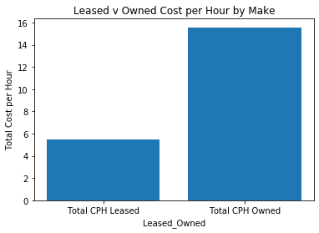

Leased vs. Owned
Make Comparison
(cost per Hour)
Total CPH Leased Total CPH Owned
Cost per Hour 5.471148 15.568888

Slide 15

Conclusion
Given the data results, Leased product is more cost efficient than Owned product to meet customer long term service goals.
The MAGIC of Data Analytics!

